Slide 1
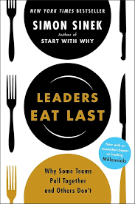
Leaders Eat Last
Why Some Teams Pull Together and Others Don’t
By: Simon Sinek
Olivia Bondurant: Leadership Book Review

Slide 2
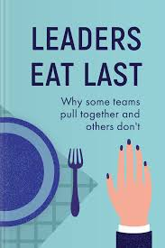
Why “Leaders Eat Last”?
I have chosen to complete this book review on “Leaders Eat Last” because as I was reading through the recommended book titles, this one stood out to me. It did not just have a regular “how to be a leader” look to it. As soon as I read “Leaders Eat Last”, I immediately realized that the meaning behind the title was so much deeper than just letting others go first at the dinner table.

Slide 3
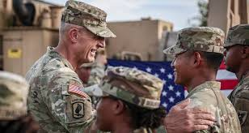
The Meaning Behind
A leader’s sacrifice
“Leaders provide the protection; the team provides the progress.”
“Leaders Eat First”
Notes:
The meaning behind “Leaders Eat First” is originated from the United States Marine Corp. Senior officers are often fed last in order to ensure all of the junior troops had enough to eat. This symbolizes a leaders willingness to make sacrifices to ensure the comfort and care of those lower than them. Not only do they work for the same company, but they are a team.

Slide 4
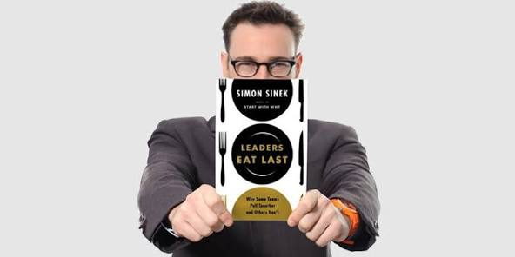
Author’s Purpose
Shift business mindset
Leadership
Sacrifice
Prioritization
Notes:
The author intended for this book to open the minds of leaders in the business world and shift their mindset from short-term profit to long-term employee satisfaction. He stresses that poor leadership can increase workplace anxiety and internal fear. Sinek shows that in order for teams to perform their best- they need to be treated fairly, feel heard, and know that they are in a safe and healthy work environment.

Slide 5
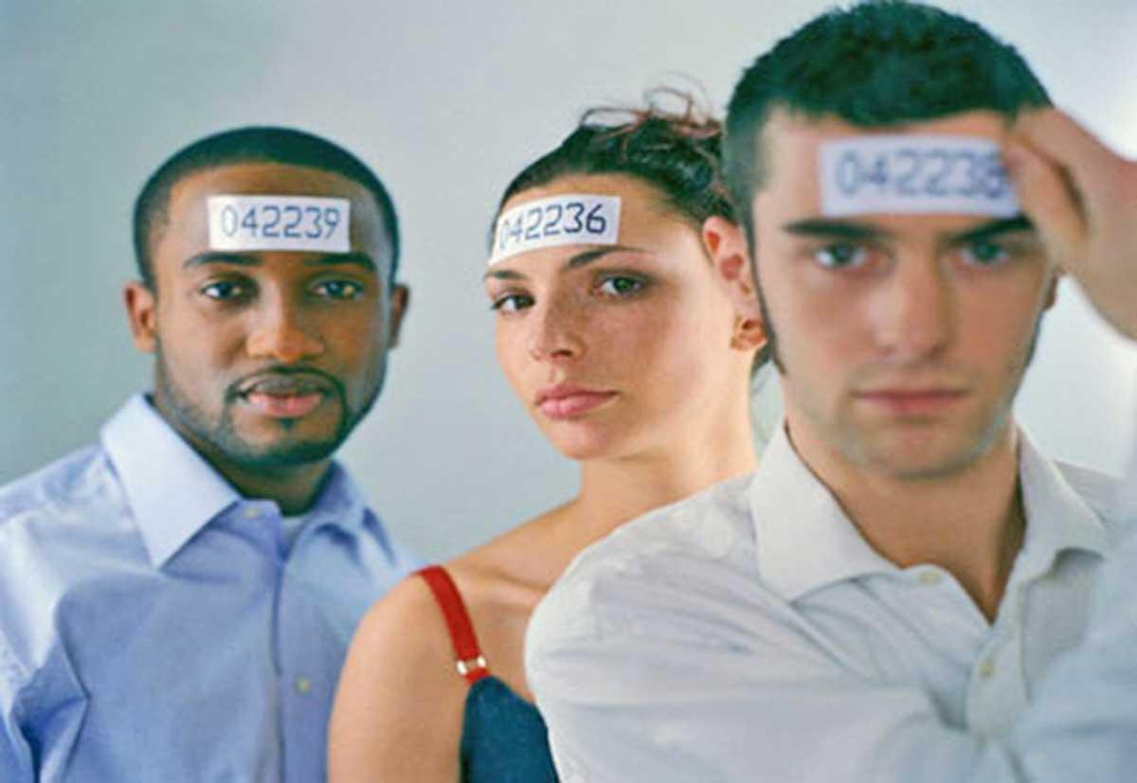
People Over Numbers
Long-term success is driven by long-term employee satisfaction, not short-term profit.
Sustainable performance comes from strong relationships, not just optimizing spreadsheet data.
If a leader treats employees like numbers, it may cause the leader to lose empathy and make short-sighted decisions that may destroy the company's culture.
Notes:
A leader’s prioritization determines the long-term effect on the company success. Prioritizing metrics over morale results in high turnover, low innovation, and chronic workplace anxiety. Sinek believes that it is in a leader’s best interest to first create an environment where the employees are safe and taken care of in order to build a company with a firm foundation.

Slide 6
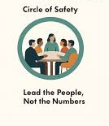
The Circle of Safety
Establish Empathy
Encourage Trust
Protect Members
Safety for employees
Reduce threat of managers and coworkers
Increased collaboration
Notes:
One of the main points in “Leaders Eat Last” is the Circle of Safety. The Circle of Safety is an illustration of a workplace. The leader in a workplace cannot control the environment going on outside of work. Although, the leader is able to control the conditions of the inside of the workplace. This circle protects employees by making sure that there is no threat to their position, favoritism, politics, etc. in which can make a person unsafe and insecure. Inside of the circle should be a safe place for employees to share ideas, admit when they are wrong, and feel free to communicate their feelings.

Slide 7
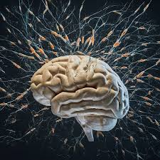
Brain Chemistry
When employees feel safe, four chemicals are released from the brain…
Endorphins - blocks pain perception, elevates mood, reduces anxiety
Dopamine - motivation, focus
Serotonin - mood regulation, helps brain process information
Oxytocin - enhances social connection, reduces anxiety
When employees do not feel safe, cortisol is released.
Cortisol - stress response
Notes:
Sinek believes that when employees feel safe, four important chemicals are released in the brain. These chemicals can especially help employees at work by giving them motivation to achieve a goal, have trust in their peers and enjoy working socially, focus throughout the shift, reduce fear and anxiety, and help the brain process information given. If a member of the group does not feel safe, cortisol may be released. Cortisol controls many things such as energy and inflammation. High or low levels of cortisol on a consistent basis can cause chronic problems in the body such as Cushing’s or Addison’s Disease.

Slide 8

Strengths
Explains core belief
People over numbers
Framework for foundation
The Circle of Safety
Biological evidence
Brain chemistry
Notes:
Sinek does a great job expanding on his belief of what a real leader is and why a leader is expected to lead by example and sacrifice for their employees. He explains that within any company setting, if employees do not feel personally valued and safe they are biologically unable to perform to their best capabilities. He then shows the foundation of how to make sure employees feel safe with the Circle of Safety. He is later able to provide evidence based on biological brain chemistry on why this tactic is reliable. By reminding leaders that employees are people, not numbers, he is able to prove his theory with science and relatability.

Slide 9

Weaknesses
Lacks step-by-step instructions
Repetitive
Notes:
Although Sinek did a wonderful job of convincing leaders of his beliefs, he did not give a step-by-step on how to correctly carry it out. Even by giving the Circle of Safety, some leaders may have no idea how to make employees feel safe and personable. This would require leaders interested in this tactic to further their research in order to accomplish “people over numbers” within their company or business. I also found his work to be repetitive when trying to get his point across and not so much digging deeper into his explanations.

Slide 10
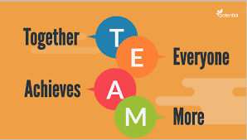
Takeaways
Being a leader is intentional.
Sacrifice and empathy are important characteristics for leaders to have.
Success is driven by looking long-term.
People work better in secure, personable environments.
Trust enhances cooperation.

Slide 11
My Recommendation
I would highly recommend the book “Leaders Eat Last” by Simon Sinek.
For anyone looking to build a company or business, it is important to keep in mind not only the logistics of things, but long-term personal goals that will enable the business to flourish and create a warm and inviting environment. It is important to allow the people who work for you to feel safe in order for them to be creative and share new ideas. Sinek reminds readers that leaders often get caught up in numbers and tend to lose their empathy for employees. This not only can cause a toxic work environment, but can be detrimental to a business’ growth.

Slide 12
References
Sinek, S. (2014). Leaders eat last: Why some teams pull together and others don't. Portfolio/Penguin.

